Slide 1
Chapter 15
ASSESSMENT OF DATA MODELS
Cios / Pedrycz / Swiniarski / Kurgan

Slide 2
Outline
Introduction
Models, Their Assessment and Selection
  The Bias-Variance Dilemma
Simple Split and Cross-Validation
Bootstrap
Occam’s Razor Heuristic
Minimum Description Length Principle
Akaike’s Information Criterion and Bayesian Information Criterion
Sensitivity, Specificity and ROC Analyses
Interestingness Criteria
© 2007 Cios / Pedrycz / Swiniarski / Kurgan

Slide 3
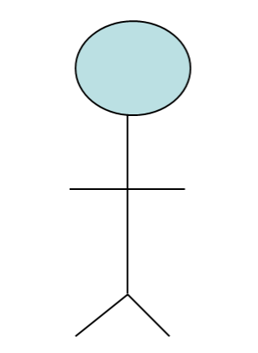
Introduction
Assessment of a data model is done by a data miner before selecting the “best” model and presenting it to the user/owner/expert of data.
Data Miner
© 2007 Cios / Pedrycz / Swiniarski / Kurgan

Slide 4
Introduction
The user then makes a final decision whether to accept the model in its current form, and use it for some purpose, or ask to generate a new one (a frequent outcome) .
User/Owner
© 2007 Cios / Pedrycz / Swiniarski / Kurgan

Slide 5
Introduction
The user’s expectation of a DM project is to find some new information/knowledge, hidden in the data, so that it can be used for some advantage.
User/Owner
© 2007 Cios / Pedrycz / Swiniarski / Kurgan

Slide 6
Introduction
Problem:
A data miner assesses quality of the generated model often by using the same data that were used to generate the model itself (albeit divided into training and testing data sets),
while the owner/user depends not only on data and DM results but also on his deep (expert) domain knowledge.
In spite of the KDP requirement that the data miner learns about the domain and the data as much as possible,
his or her knowledge obviously constitutes only a subset of the knowledge of the experts (data owners).
© 2007 Cios / Pedrycz / Swiniarski / Kurgan

Slide 7
Introduction
To illustrate this , let us note that the best bio-informaticians would be those with doctoral degrees and experience in both molecular biology and computer science, which is rarely the case.
Data miner here are computer scientist, who knows only the bits and pieces about molecular biology.
© 2007 Cios / Pedrycz / Swiniarski / Kurgan

Slide 8
Introduction
In practice:
A data miner generates several models of the data and must choose one “best” model, in terms of how well it explains
the training data and
its predictive power,
before presenting it to the data owner. We will discuss the methods for selecting such “best” models.
Model selection - The process of selecting the “best” model by a data miner.
Interestingness measures – The measure designed(artificial) by data miners to come up with the process, the same way the data users uses to assess the model. Data miners attempt to mimic experts.
Next, we focus on the heuristic, data-reuse (data re-sampling), and analytic methods for model selection and validation.
© 2007 Cios / Pedrycz / Swiniarski / Kurgan

Slide 9
Introduction
Terms model, classifier, and estimator will be used interchangeably.
A model can be defined as a description of causal relationships between input and output variables.
A classifier is a model of data used for a classification purpose: given a new input, it assigns it to one of the classes it was designed/trained to recognize.
An estimator is a method used to calculate a parameter; it is a variable defined as function of the sample values.
© 2007 Cios / Pedrycz / Swiniarski / Kurgan

Slide 10
Introduction
The number of independent pieces of information required for estimating the model is called model’s degree of freedom.
When the number of degree of freedom is equal to the number of parameters, originates one of the simplest heuristics for model selection is to choose a parsimonious model.
Parsimonious model: one that uses the fewest number of parameters – from among several acceptably well-performing models.
© 2007 Cios / Pedrycz / Swiniarski / Kurgan

Slide 11
Introduction
When we talk about models, there is always a model error associated with any model.
It is calculated as a difference between the true value and the model output value, and is expressed either as absolute or squared error between the observed/true and model output values.
Model error can be calculated only if training data, meaning known inputs corresponding to known outputs, are available.
© 2007 Cios / Pedrycz / Swiniarski / Kurgan

Slide 12
Introduction
When we generate a model of the data, we say that we fit the model to the data.
In addition to fitting the model to the data we are also interested in using the model for prediction.
Once we have generated several models and have selected the “best” one, we need to validate the model for its goodness of fit (fit error) and its
goodness of prediction (prediction error).
© 2007 Cios / Pedrycz / Swiniarski / Kurgan

Slide 13
Introduction
In neural network and ML literature, goodness of prediction is often referred to as the generalization error. The latter term ties it into the concepts of overfitting and underfitting the data.
Overfitting means unnecessary increase of the model complexity. For example, increasing the number of parameters and the model degrees of freedom beyond what is necessary.
Underfitting is opposite to overfitting, i.e., too simple a model will not fit the data well.
© 2007 Cios / Pedrycz / Swiniarski / Kurgan

Slide 14
Bias-Variance Dilemma
Bias is defined as the error that cannot be reduced by increasing the sample size:
it is present even if an infinite sample is available
it is a systematic error.
Some example sources of bias:
- measurement error (experimental error that cannot be removed)
- sample error (sample may not be correctly drawn from the population, and thus may not represent the data correctly)
- error associated with a particular form of an estimator, etc.
© 2007 Cios / Pedrycz / Swiniarski / Kurgan

Slide 15
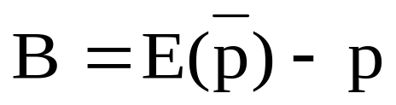
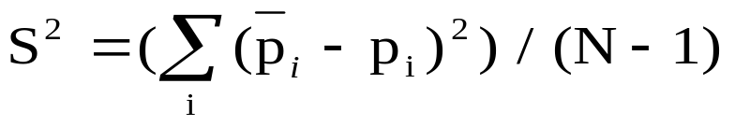
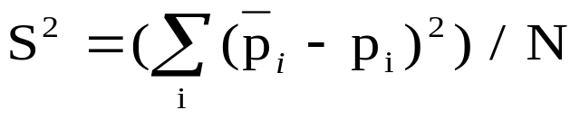
Bias-Variance Dilemma
Bias is calculated as a difference between the estimated expected value and the true value of some parameter:
Its squared value, B2, is one of the two components (the other is variance, S)
of the mean square error, MSE, which calculates the mean square difference
between a true value of a parameter, p, and its estimated value:
where the variance is:
© 2007 Cios / Pedrycz / Swiniarski / Kurgan

Slide 16
Bias-Variance Dilemma
Variance is an additional (to bias) error that is incurred given a finite sample (because of sensitivity to random fluctuations). Its defined as the deviation of prediction. In simple words it’s the amount which tell us how much the predicted value will be affected when different data is used for same or different model.
Estimator is a method used to calculate a parameter.
Biased estimators have a non-zero bias
(meaning that the estimated expected value is different
from the true value)
while
unbiased estimators have zero bias of the estimate.
© 2007 Cios / Pedrycz / Swiniarski / Kurgan

Slide 17
Bias-Variance Dilemma
There exist a trade-off between bias and
variance, known as the bias-variance dilemma.
For a given MSE, if it has large bias then it has a small
accompanying variance, and vice versa.
We are interested in finding a model/estimator which is
neither too complex (may overfit the data)
nor too simple (may underfit the data).
Such a model can be found by minimizing the MSE value, with acceptable bias and variance.
© 2007 Cios / Pedrycz / Swiniarski / Kurgan

Slide 18
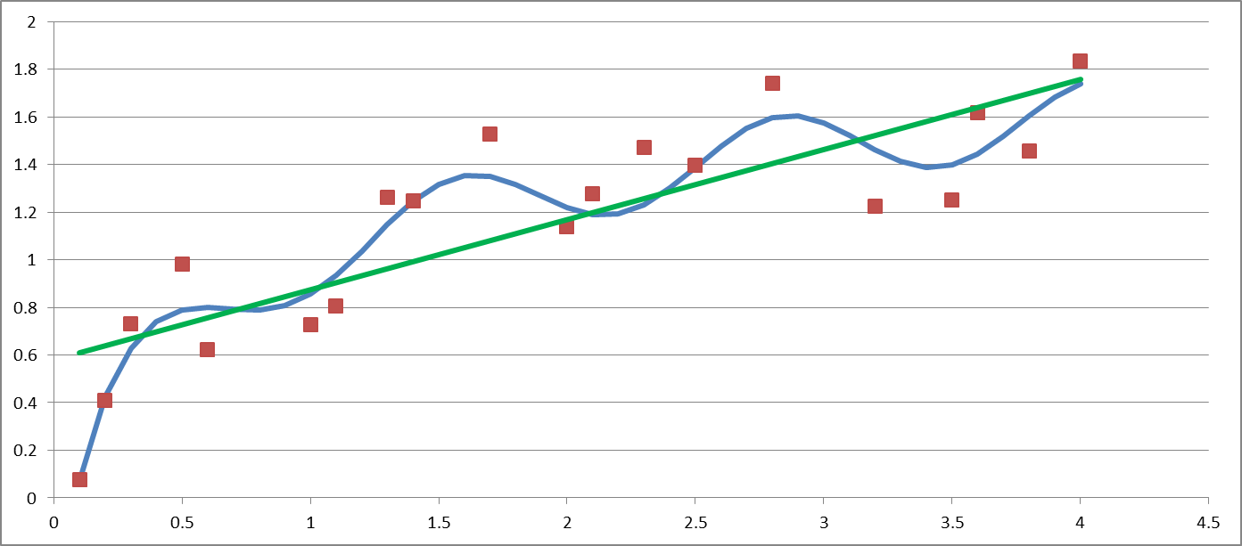
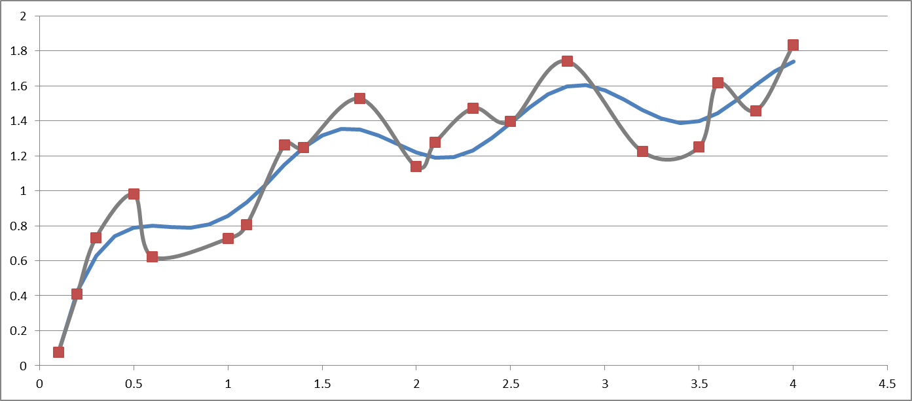
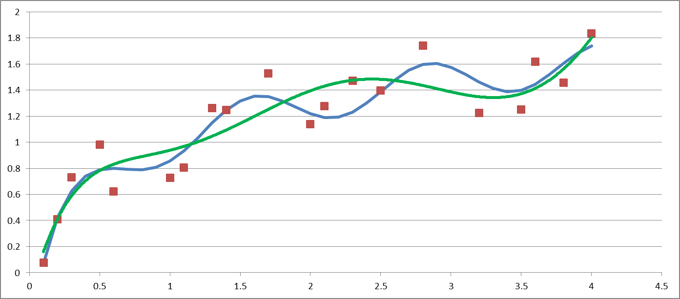
Bias-Variance Dilemma
High Bias, Low Variance
Low Bias, High Variance
Medium Bias, Medium Variance

Slide 19
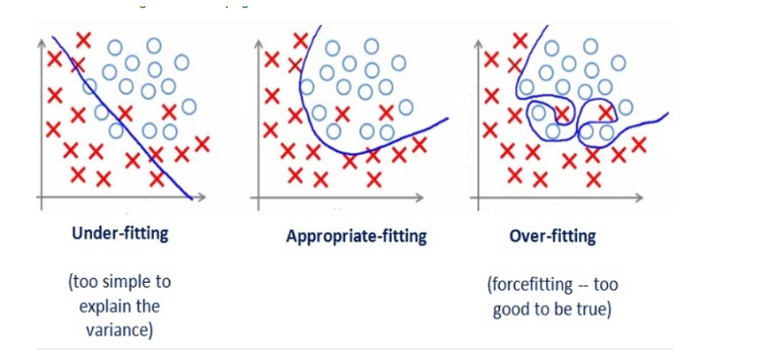
https://medium.com/greyatom/what-is-underfitting-and-overfitting-in-machine-learning-and-how-to-deal-with-it-6803a989c76_x000b_Example
© 2007 Cios / Pedrycz / Swiniarski / Kurgan

Slide 20
Bias-Variance Dilemma
Bias Variance MSE
MSE
Variance
Bias
optimal
Model complexity
Data size
Illustration of the bias -variance dilemma.
© 2007 Cios / Pedrycz / Swiniarski / Kurgan

Slide 21
Bias-Variance Dilemma
A model should be chosen in such a way that it does not overfit the data,
which means that it should perform acceptably well on both training and test data,
as measured by the error between the true/desired value and the model output value.
High dimensionality increases variance (curse of dimensionality)
  Removing irrelevant features (feature selection) can improve accuracy.
© 2007 Cios / Pedrycz / Swiniarski / Kurgan

Slide 22
Bias-Variance Dilemma
Fit/Training &
Prediction/Test
Errors
High bias & low variance
Low bias & high variance
underfitting
Test data
Training data
overfitting
optimal
Model complexity
Data size
Choosing optimally complex model with acceptable fit and prediction errors.
© 2007 Cios / Pedrycz / Swiniarski / Kurgan

Slide 23
Assessment Techniques
Model assessment techniques can be divided based on the nature of the methods:
data-reuse / re-sampling
(simple split, cross-validation, bootstrap)
heuristic
(parsimonious model, Occam’s razor)
analytical
(Minimum Description Length, Aikake’s Information Criterion, and Bayesian Information Criterion)
interestingness measures
© 2007 Cios / Pedrycz / Swiniarski / Kurgan

Slide 24
Simple Split
Test Data
Training Data
Given a large data set composed of known inputs corresponding to known outputs,
we can evaluate the model by splitting the available
data into two parts:
the training part used for fitting the model, and
the test part used for evaluation of its goodness of prediction.
Holding back 1/3 (or ½) of data for testing is typical.
© 2007 Cios / Pedrycz / Swiniarski / Kurgan

Slide 25
Simple Split and Cross-Validation
If the results are unsatisfactory, then a more expensive computational method, called
cross-validation, is used to estimate the goodness of prediction of the model.
Informally, cross validation should be used in situations
where the data set is relatively small but “difficult”
(meaning that splitting into just two parts does not result
in good prediction).
© 2007 Cios / Pedrycz / Swiniarski / Kurgan

Slide 26
Cross-Validation
Let n be the number of data points in the training data set. Let k be an integer index that is much smaller than n.
In a k-fold cross validation, we divide the entire data set into k equal-size subsets, and use k-1 parts for training and the remaining part for testing and calculation of the prediction error (goodness of prediction).
We repeat the procedure k number of times, and report the average error from the k runs.
In an extreme situation, when data set is very small, n-fold cross validation, also known as leave-one-out method, is used.(no. of data points = no. of the folds)(i.e N=K)
© 2007 Cios / Pedrycz / Swiniarski / Kurgan

Slide 27
Cross-Validation
Example:
Imagine we have a data sample with 6 observations:
[0.1, 0.2, 0.3, 0.4, 0.5, 0.6]
The first step is to pick a value for k in order to determine the number of folds used to split the data. Here, we will use a value of k=3. That means we split the data into 3 groups. Because we have 6 observations, each group will have an equal number of 2 observations.
For example, we get the following folds:
Fold1: [0.5, 0.2]
Fold2: [0.1, 0.3]
Fold3: [0.4, 0.6]
Three models are trained and evaluated with each fold given a chance to be the held out test set.
For example:
Model1: Trained on Fold1 + Fold2, Tested on Fold3
Model2: Trained on Fold2 + Fold3, Tested on Fold1
Model3: Trained on Fold1 + Fold3, Tested on Fold2
The models are then discarded after they are evaluated as they have served their purpose.
© 2007 Cios / Pedrycz / Swiniarski / Kurgan

Slide 28
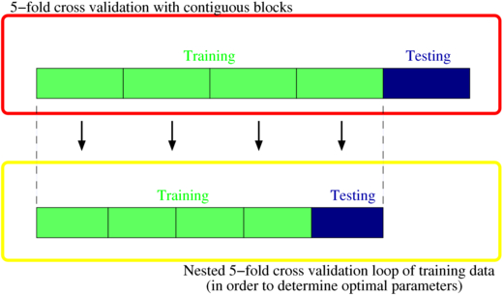
Nested Cross-Validation

Slide 29
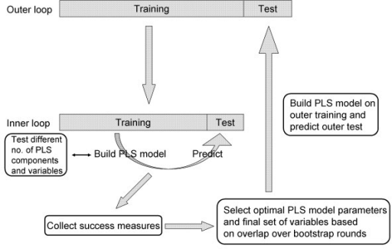
Nested Cross-Validation
From “Repeated double cross validation” by Filzmoser et al.

Slide 30
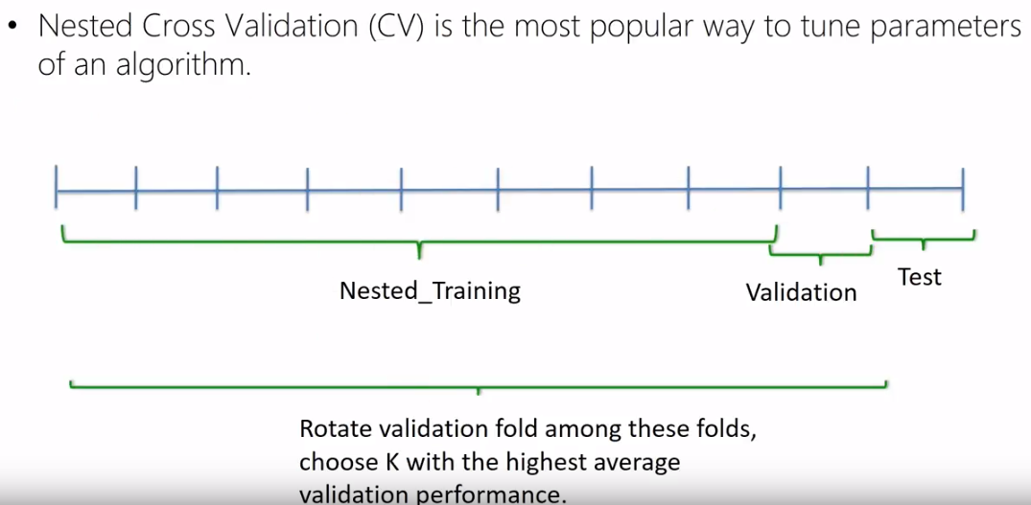
Nested Cross-Validation
Example
© 2007 Cios / Pedrycz / Swiniarski / Kurgan

Slide 31
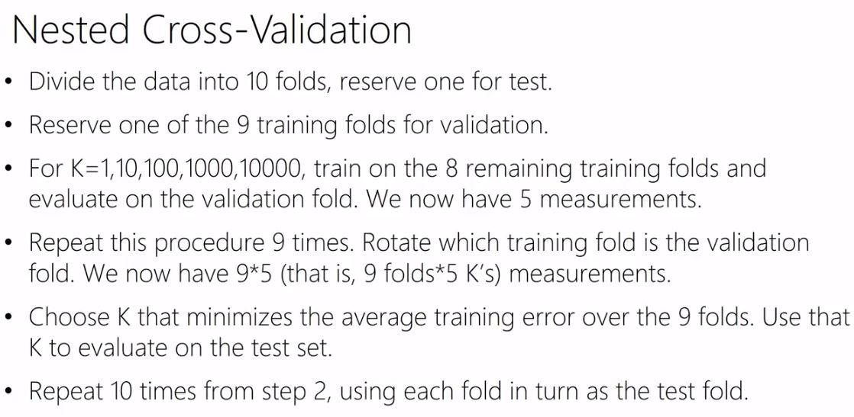
Nested Cross-Validation
https://www.youtube.com/watch?v=LpOsxBeggM0

Slide 32
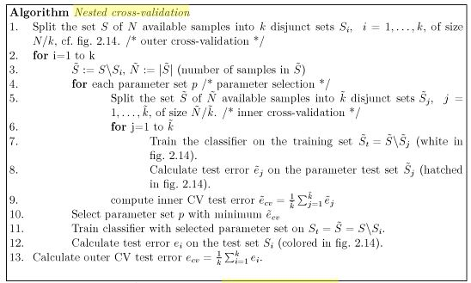
Nested Cross-Validation

Slide 33
Cross-Validation
Advantages:
All data used for training
All data used for test (once)
No data wasted
Disadvantages:
Computationally more expensive than simple split (brute force)
Good bias performance can have high variance.
  Increasing k gives better bias, worse variance
© 2007 Cios / Pedrycz / Swiniarski / Kurgan

Slide 34
Bootstrap
Bootstrap gives a nonparametric estimate of the error of a model in terms of its bias and variance.
It works as follows:
We draw x samples of equal size from a population consisting of n samples,
with the purpose of calculating confidence intervals for
the estimates.
A strong assumption is made that the available data set of n samples constitutes the population itself.
© 2007 Cios / Pedrycz / Swiniarski / Kurgan

Slide 35
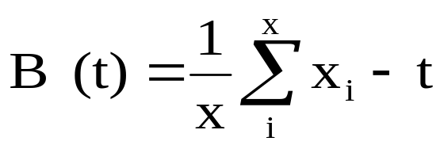
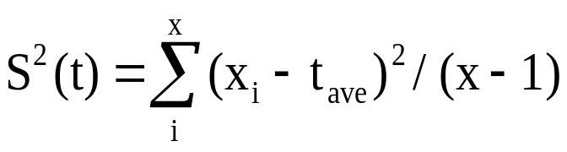
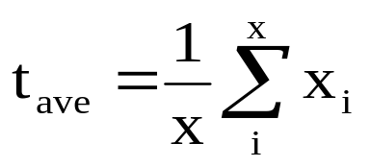
Bootstrap
First, from this “population”, x samples of size n
(notice that it is of the same size as the original data set)
called bootstrap samples, are drawn, with replacement.
Next, we fit a model to each of the x bootstrap samples and assess goodness of fit (error) for each of the bootstrap samples and average it over the x bootstrap samples
(let us denote by xi the ith realization of the bootstrap sample, where i=1 , …, x)
and calculate the bootstrap estimate of the bias and variance as:
© 2007 Cios / Pedrycz / Swiniarski / Kurgan

Slide 36
Bootstrap
Assume the available data set of n samples is the population itself.
Draw “x bootstrap samples”, with replacement, from the population of size n (the same size as the original data)
  With replacement means that we don’t remove the points from the population when selected, so they may appear multiple times in a single sample.
Fit the model to each bootstrap sample and test it against the original data.
Average the error over the x bootstrap samples.
© 2007 Cios / Pedrycz / Swiniarski / Kurgan

Slide 37
Bootstrap
Data (original):
a b c d e f g h i j
Sample 1:
f g e a j g b d d i
Train
Test
Err1
Sample 2:
d f I e g j a e j h
Train
Test
Err2
Sample 3:
b d j e b g h j d f
Train
Test
Err3
Calculate the bootstrap estimate of the bias and variance as:
x_{i} is the ith realization of the bootstrap sample, from i=1,…,x
and t is the estimate calculated from the original data
© 2007 Cios / Pedrycz / Swiniarski / Kurgan

Slide 38
Bootstrap
To use bootstrap for calculating goodness of prediction we treat the set of bootstrap samples as the training data set, and the original data set as the test set.
We thus fit the model to all bootstrap samples, and calculate the prediction error on the original data.
The problem with this approach is that prediction error is optimistic (good), since the bootstrap samples are drawn with replacement.
In other words, we calculate the prediction/generalization error on highly overlapping data (with many data items in the test set being the same as in the training data).
Kind of “cheating” (note that CV is less optimistic).
© 2007 Cios / Pedrycz / Swiniarski / Kurgan

Slide 39
Bootstrap Cross Validation
To address the optimism of bootstrap:
Generate x bootstrap samples of size n
Perform leave-one-out CV on each bootstrap sample
Average the CV estimates for each of the x bootstrap samples
This reduces the issue of testing on the same data as used for training, but the same instance can still appear multiple times in one bootstrap sample. Thus, bootstrap CV still underestimates the true error.
Fu, Carrol, Wang 2005. Estimating misclassification error with small samples via bootstrap cross-validation. Bioinformatics, Vol 21, Issue 9 pg 1979-1986.
© 2007 Cios / Pedrycz / Swiniarski / Kurgan

Slide 40
.632 Bootstrap
Bootstrap is an optimistically biased estimator, due to test/training data overlap.
.632 Bootstrap corrects this bias by combining two biased estimators: Zero Bootstrap estimator and Resubstitution estimator.
Zero bootstrap: Use bootstrap sample to train, and use only the samples not in a bootstrap as test data (eliminates test/training overlap).
  This is a very pessimistic estimator.
Efron, Bradley 1983. Estimating the Error Rate of a Prediction Rule: Improvement on Cross-Validation. Journal of the American Statistical Association, Vol 78, No. 382 pg 316-331
© 2007 Cios / Pedrycz / Swiniarski / Kurgan

Slide 41
.632 Bootstrap
Resubstitution is an error when using full data set for both training and test (this is very optimistic estimator / “true cheating”).
The probability of any given instance not being chosen from the original data/population after n samples are drawn is
(1-1/n)^{n} ~= e⁻¹ ~= 0.368
thus, probability of the expected distinct instances in a (training) sample is 0.632
We then combine these two biased estimators to correct the bias:
  err = 1/x ∑^{x}_{i=1}(0.632 * c0_{i} + 0.368 err_{s}),
  where c0_{i} is error estimate on bootstrap sample i
© 2007 Cios / Pedrycz / Swiniarski / Kurgan

Slide 42
.632 Bootstrap
Data:
a b c d e f g h i j
Train
Test
err_{s}
c h
Sample 1:
f g e a j g b d d i
Train
Test
c0₁
b c i
Sample 2:
d f I e g j a e j h
Train
Test
c0₂
a c j
Sample 3:
b d i e b g h i d f
Train
Test
c0₃
  err = 1/3 [(0.632 c0₁ + 0.368 err_{s}) + (0.632 c0₂ + 0.368 err_{s}) + (0.632 c0₃ + 0.368 err_{s}) ]
© 2007 Cios / Pedrycz / Swiniarski / Kurgan

Slide 43
Occam’s Razor Heuristic
Occam’s razor states that the simplest explanation (a model) of the observed phenomena, in a given domain, is the most likely to be a correct one.
Although we do not know how to determine “the simplest explanation” we intuitively agree with William of Ockham that given several models
(specified, for example, in terms of production IF… THEN… rules)
a more “compact” model
(composed of a fewer number of rules, especially if on average the rules in this model are shorter than in all other models)
should be chosen.
© 2007 Cios / Pedrycz / Swiniarski / Kurgan

Slide 44
Occam’s Razor Heuristic
Occam’s razor heuristic is built-in into most machine learning algorithms, namely, that simpler/shorter/more compact description of the data is preferred over more complex ones.
Thus, a problem with this heuristic is that we plan to use it for a model assessment while we have already used it for generating the model itself!
Another issue with Occam’s razor is that some researchers say that it may be entirely incorrect, because:
if we model some data (process that generated the data)
known to be very complex why should a simple model of the data be preferred at all?
© 2007 Cios / Pedrycz / Swiniarski / Kurgan

Slide 45
Minimum Description Length Principle
MDL principle was designed to be general and, importantly, independent of any underlying probability distribution.
Its “father”, Rissaneen, wrote: “We never want to make a false assumption that the observed data actually were generated by a distribution of some kind, say, Gaussian, and then go on and analyze the consequences and make further deductions.
Our deductions can be entertaining but quite irrelevant…”.
This statement is in stark contrast to statistical methods, because the MDL provides a clear interpretation regardless of whether some underlying “true” model of data exists or not.
© 2007 Cios / Pedrycz / Swiniarski / Kurgan

Slide 46
Minimum Description Length Principle
The basic idea of the MDL is connected with a specific understanding of learning (model building).
Namely, MDL is about finding regularities in the data, where regularity is understood as the ability to compress the data.
Learning can also be understood as the ability to compress the data, i.e., we want to come up with compact (e.g., with fewer number of rules) description of the data (the model).
© 2007 Cios / Pedrycz / Swiniarski / Kurgan

Slide 47
Minimum Description Length Principle
In parlance of machine learning, we desire to select the most general model but one that does not overfit the data.
In parlance of MDL, having a set of models (M) about the data (D) we want to select the model that most compresses the data.
Both methods specify the same goal, but are stated using different terminology.
© 2007 Cios / Pedrycz / Swiniarski / Kurgan

Slide 48
Minimum Description Length Principle
If a system can be defined in terms of input and corresponding output data, then in the worst case (longest), it can be described by supplying the entire data set, thus constituting the longest (least compressed) model of the data.
However, if regularities can be discovered in the data, say, expressed in the form of production rules, then a much shorter description is possible, and it can be measured by the MDL principle.
The MDL principle says that the complexity of a model/hypothesis is measured by the number of bits needed to encode the model itself, plus the number of bits needed to encode the data using the model.
© 2007 Cios / Pedrycz / Swiniarski / Kurgan

Slide 49
Minimum Description Length Principle
Formally, from a set of models, we choose as the “best” the model that minimizes the following sum:
L(M) + L(D│M)
where L(M) is length (in bits) of the description of the model, and L(D│M) is length of the description of data encoded using model M.
The basic idea behind this definition can be also explained using notions of underfitting and overfitting.
It is easy to find a complex model, meaning one having large L(M) value that overfits the data (i.e., with small L(D│M) value).
It is equally easy to find a simple model, with the small L(M) value that underfits the data, but which has large L(D│M) value.
Notice the similarity of the MDL principle to the bias-variance dilemma.
© 2007 Cios / Pedrycz / Swiniarski / Kurgan

Slide 50
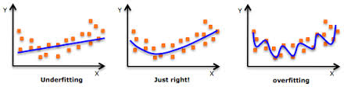
Minimum Description Length Principle
What we are looking for is a model that constitutes the best compromise between the two cases.
Suppose that we have generated two models that explain/fit the data equally well, then the MDL principle tells us to choose one that is simpler
(for instance having smaller number of parameters; recall that a model using the smallest number of parameters is called parsimonious),
and that allows for the most compact description of the data.
In that sense, the MDL can be seen as a formalization of the Occam’s razor heuristic.
Small L(M) & Large L(D|M)
Large L(M) & small L(D|M)
© 2007 Cios / Pedrycz / Swiniarski / Kurgan

Slide 51
References
Cios, K.J., Pedrycz, W. and Swiniarski, R. 1998. Data Mining Methods for Knowledge Discovery. Kluwer
Grunwald PD, Myung I.J and Pitt MA (eds.). 2005. Advances in Minimum Description Length Theory and Applications. MIT Press
Hastie T, Tibshirani R and Friedman J. 2001. The Elements of Statistical Learning: Data Mining, Inference and Prediction. Springer
Hilderman RJ and Hamilton HJ. 1999. Knowledge Discovery and Interestingness Measures: A Survey. Technical Report CS 99-04, University of Regina, Regina, Saskatchewan, Canada
Moore GW and Hutchins GM. 1983. Consistency versus completeness in medical decision-making: Exemplar of 155 patients autopsied after coronary artery bypass graft surgery. Med Inform (London). Jul-Sep., 8(3):197-207
Kecman V. 2001. Learning and Soft Computing. MIT Press
Rissaneen J. 1989. Stochastic Complexity in Statistical Inquiry. World Scientific
van Rijsbergen, C.J. 1979. Information Retrieval. London. Butterworths
© 2007 Cios / Pedrycz / Swiniarski / Kurgan

Slide 52
References
Kamber & Shingal. 1996 Evaluating the Interestingness of Characteristic Rules. Application of Mathematical Theoreis. AAAI.org
Mehta, Agrawal & Rissanen, SLIQ: A Fast Scalable Classifier for Data Mining
Cavanaugh J., 2012 Lecture V: The Bayesian Information Criterion, Department of Biostatistics, Department of Statistics and Actuarial Science, Univ. of Iowa
Mazerolle, 2007, Making sense out of Akaike’s Information Criterion (AIC) http://avesbiodiv.mncn.csic.es/estadistica/senseaic.pdf
Efron, B. 1983. Estimating the Error Rate of a Prediction Rule: Improvement on Cross-Validation. Journal of the American Statistical Association, Vol 78, No. 382 pg 316-331.
Fu, Carrol, Wang. 2005. Estimating misclassification error with small samples via bootstrap cross-validation. Bioinformatics, Vol 21, Issue 9 pg 1979-1986.
© 2007 Cios / Pedrycz / Swiniarski / Kurgan

